Slide 1
Object Basics
資訊二
鄭宇軒

Slide 2
outline
Casual talk
C versus C++
OOP
Class
Access modifiers
Conventions
UML
Review

Slide 3

Casual talk

Slide 4
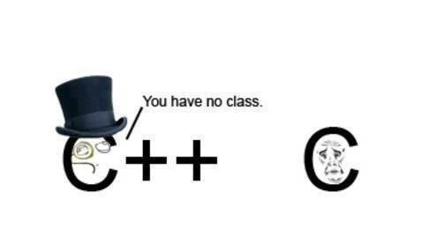
C versus c++
What is OOP?
And why do we need
to know OOP?

Slide 5

C versus c++
C++

Slide 6


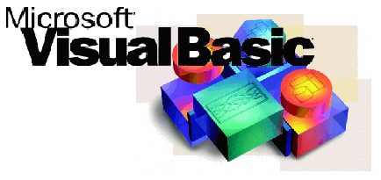

C versus c++
This is the reason why.

Slide 7
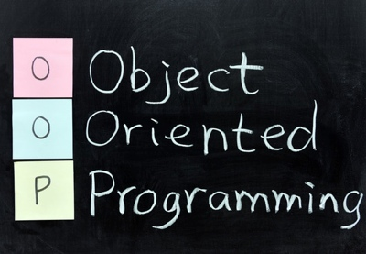
OOP

Slide 8
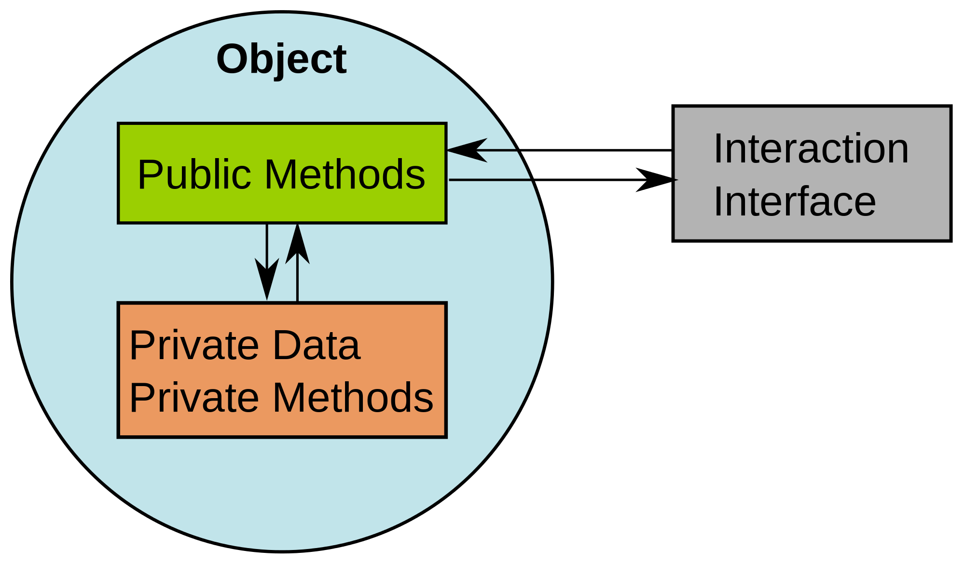
OOP

Slide 9


OOP

Slide 10
OOP

Slide 11
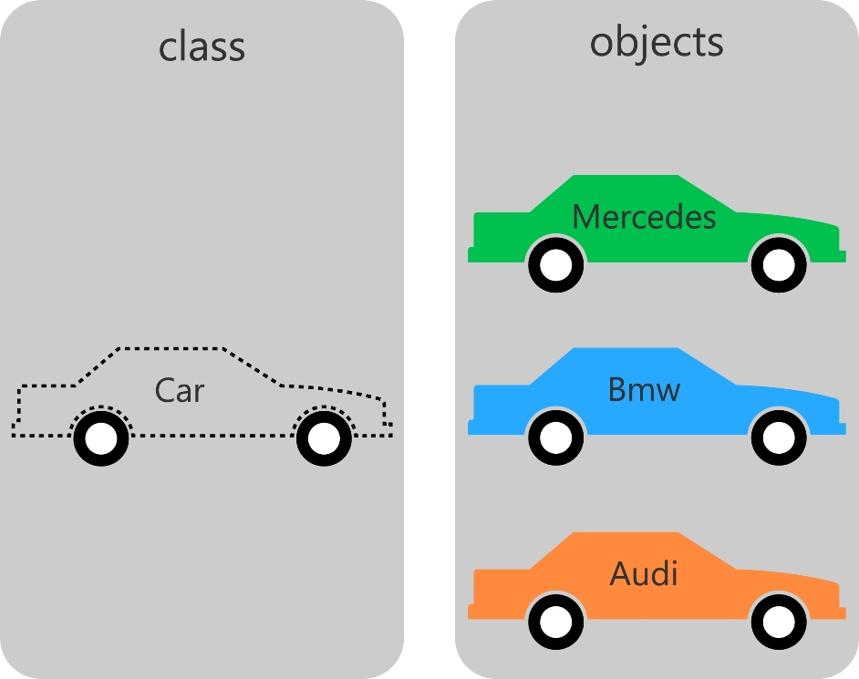
class

Slide 12
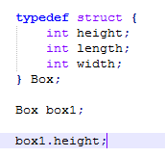
Class

Slide 13
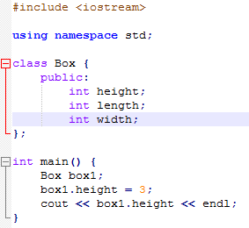
class
Notes:
Practice

Slide 14
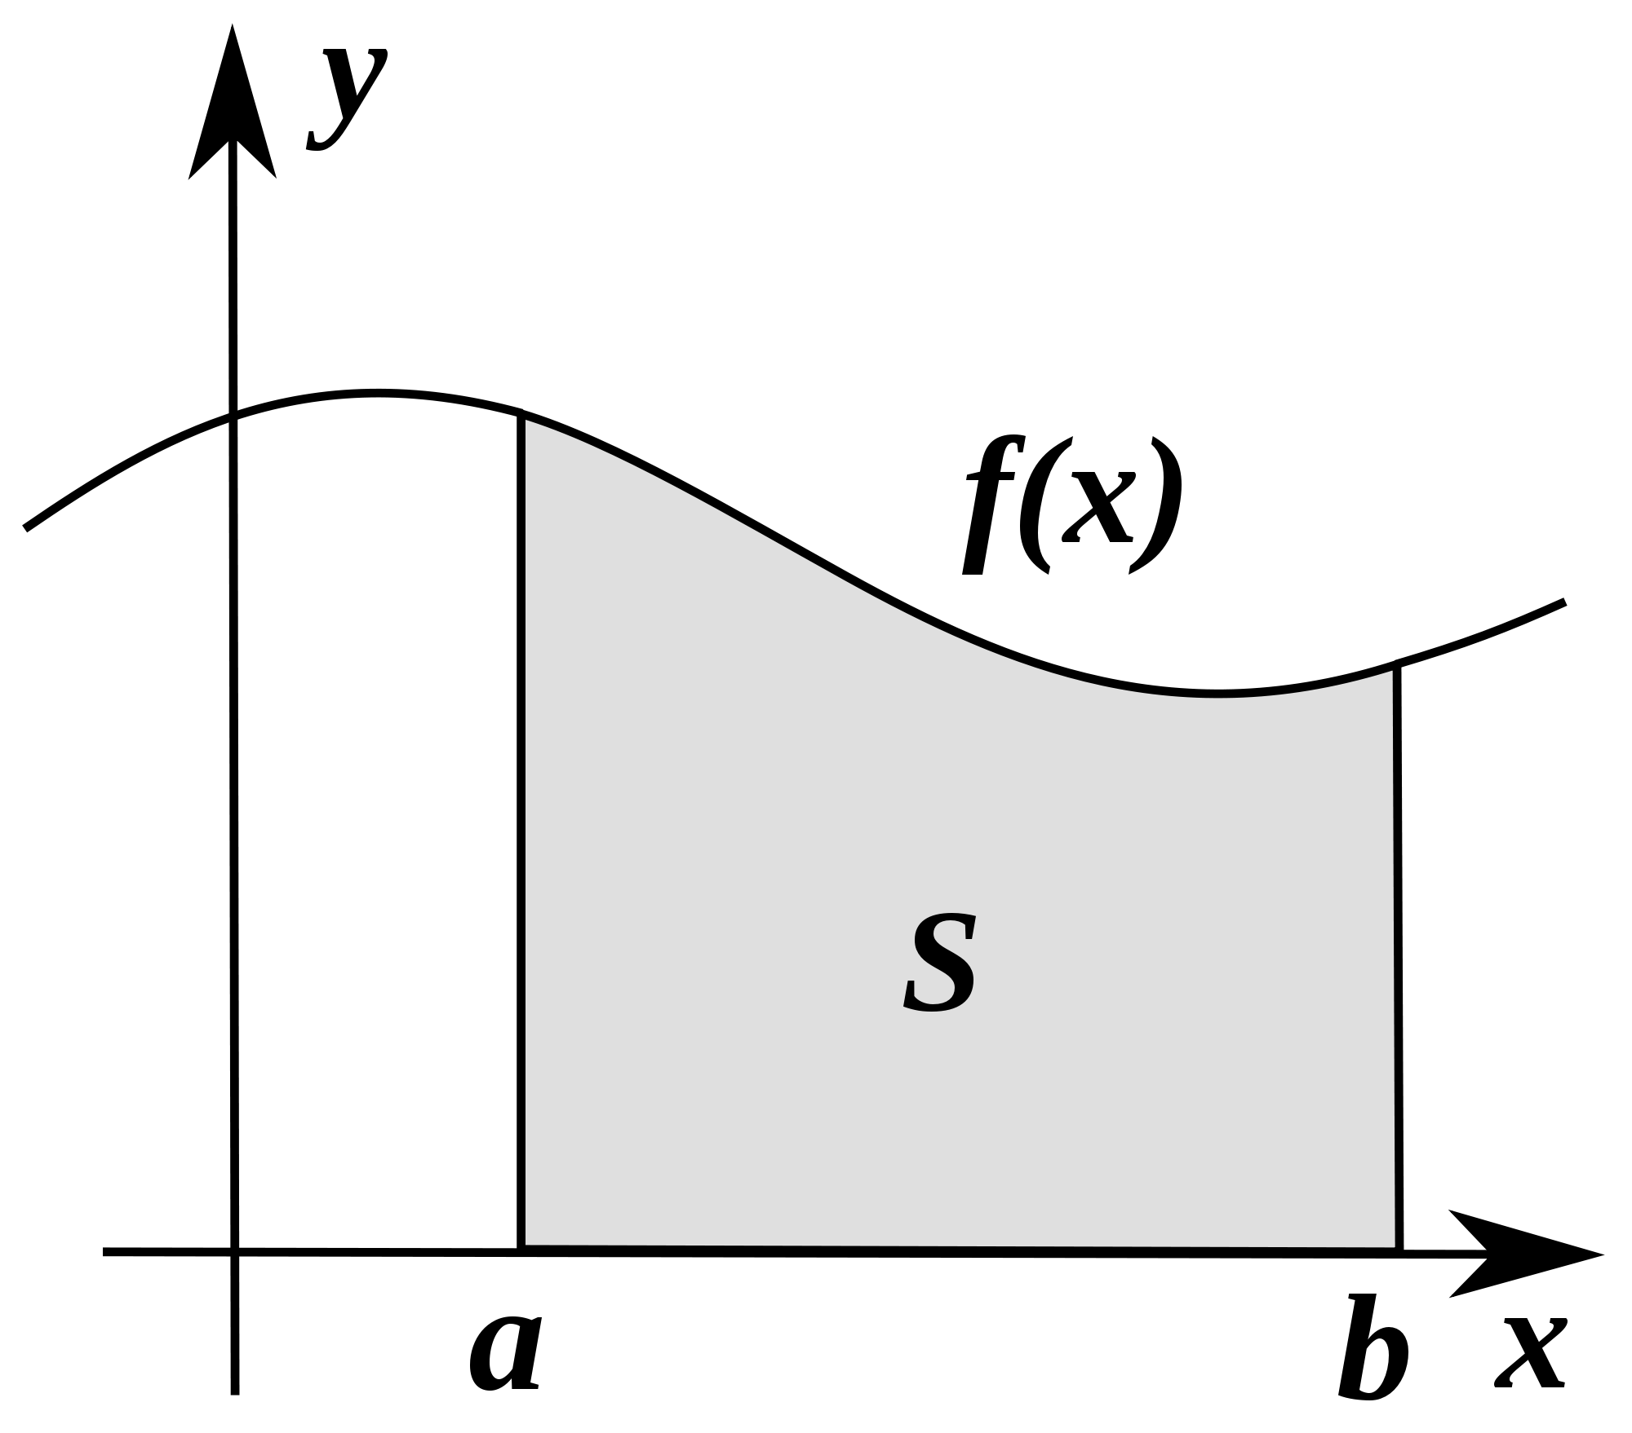
class

Slide 15
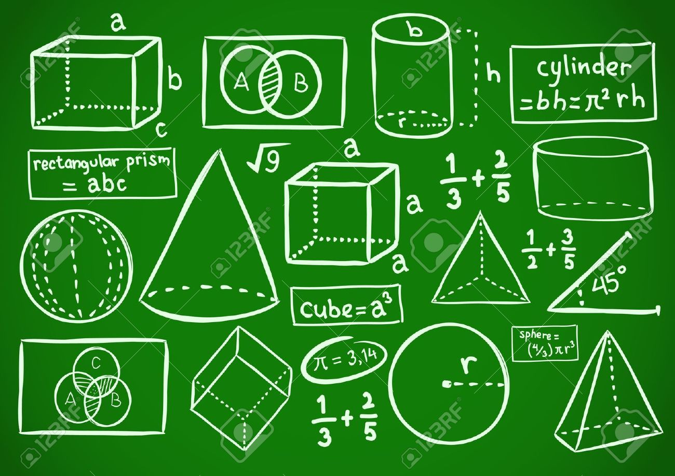
class

Slide 16
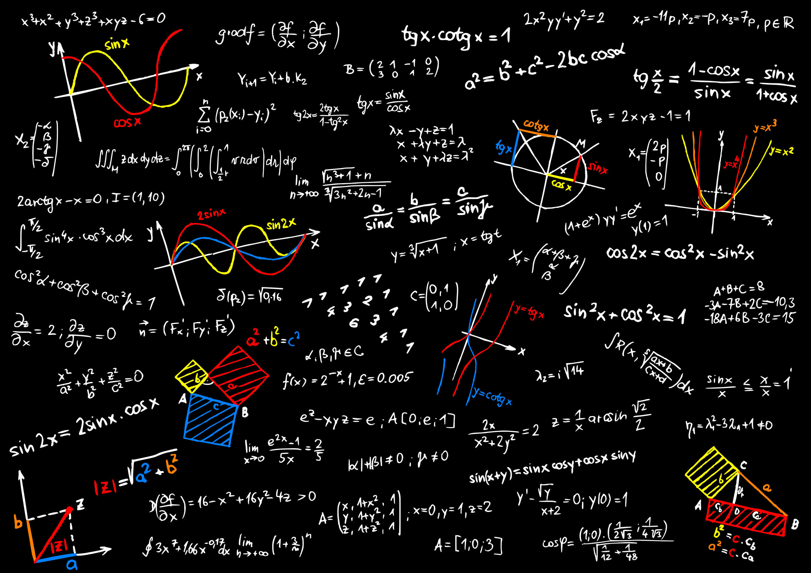
class

Slide 17

class

Slide 18
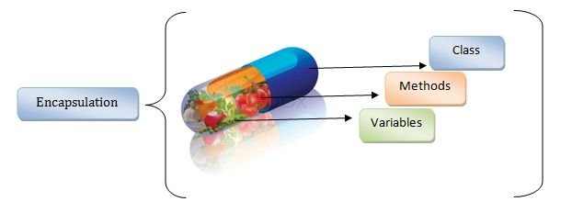
class

Slide 19
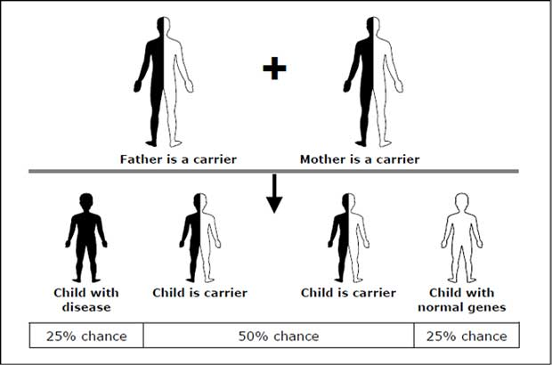
class

Slide 20
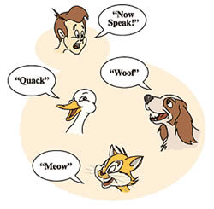
class

Slide 21

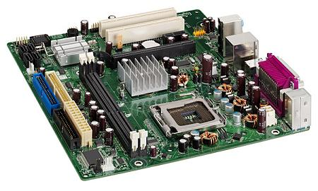
class

Slide 22
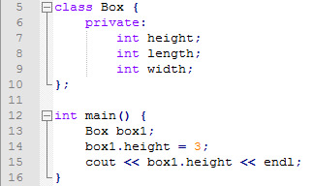
Access modifiers
Notes:
practice

Slide 23
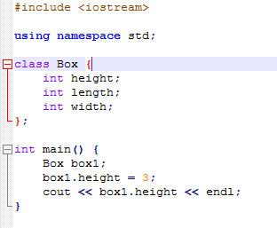
Access modifiers
Notes:
Practice

Slide 24
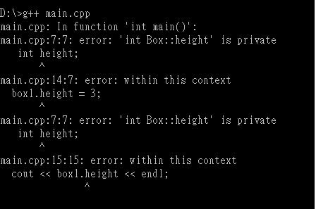
Access modifiers

Slide 25


Access modifiers
Private
Public

Slide 26
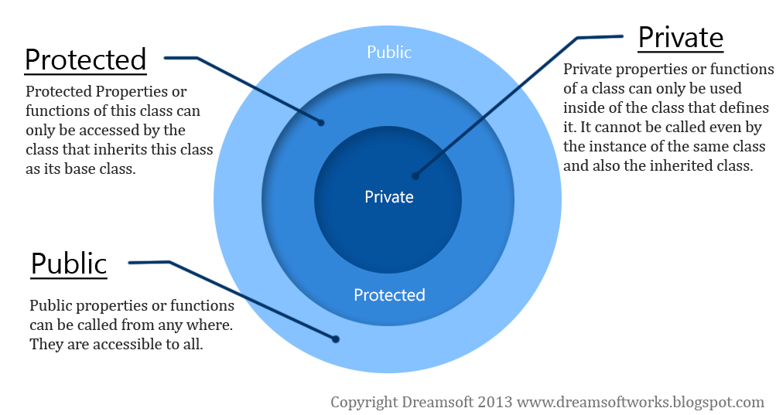
Access modifiers

Slide 27
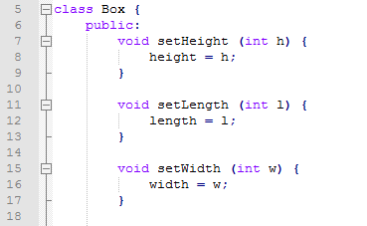
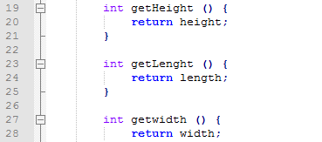
conventions
Notes:
practice

Slide 28
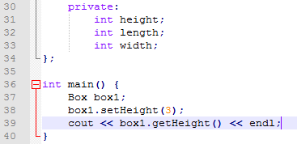
Conventions
Notes:
practice

Slide 29
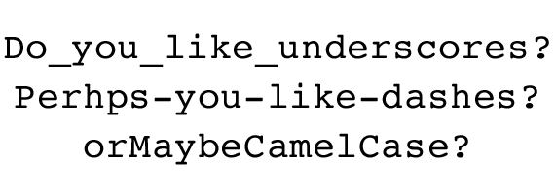
Conventions

Slide 30
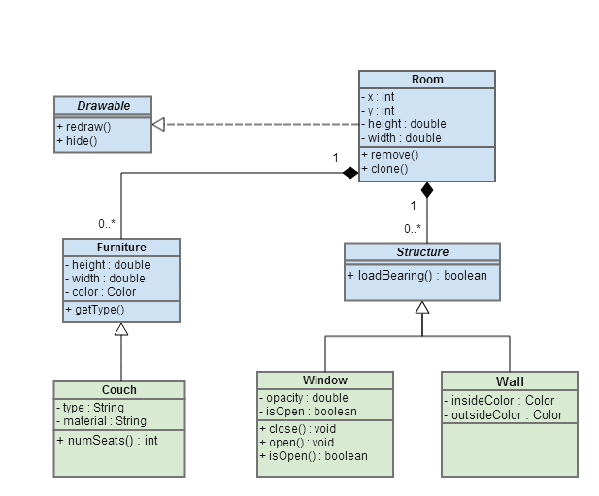
UML

Slide 31
UML
Box
- height: int - length: int - width: int
+ setHeight(h: int) + setLength(l: int) + setWidth(w: int) + getHeight(): int + getLength(): int + getWidth(): int

Slide 32


review

Slide 33
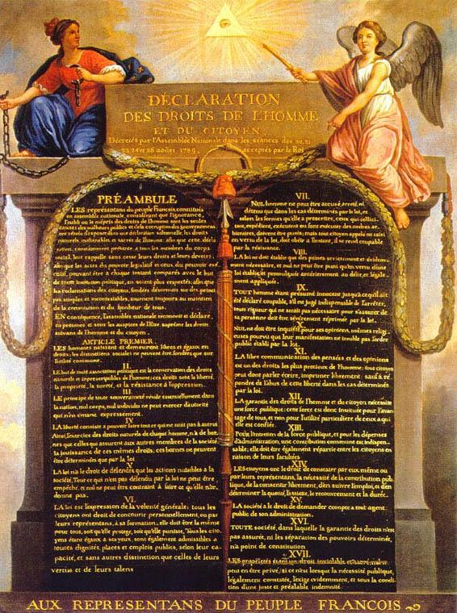

review

Slide 34

Review

Slide 35
